Slide 1

Phishing: Don't Get Hooked!
Phishing attacks are a growing threat. They trick individuals into revealing sensitive information. Stay informed and protect yourself from online dangers.

Slide 2
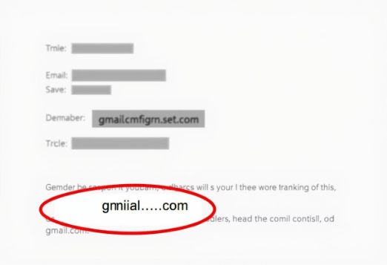
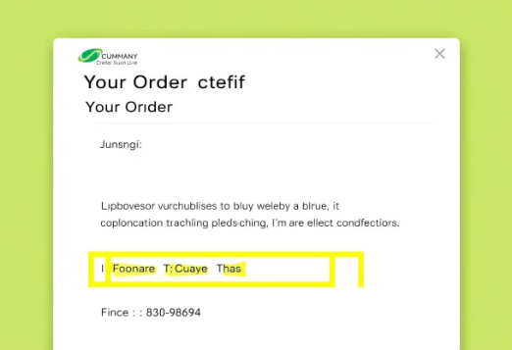
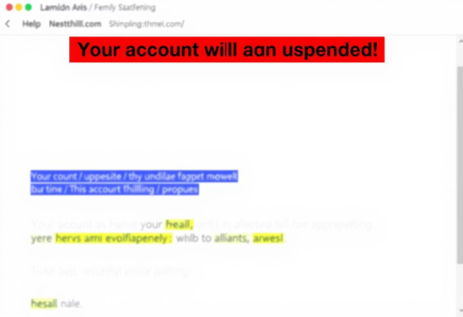
Spotting Phishing Emails
Check Sender's Address
Beware Urgent Language
Watch for Generic Greetings
Look for misspellings or unusual domains. Scrutinize every character.
"Act now!" or "Account suspended!" are common scare tactics. Legitimate warnings are rare.
"Dear Customer" is a red flag. Real organizations use your name.

Slide 3
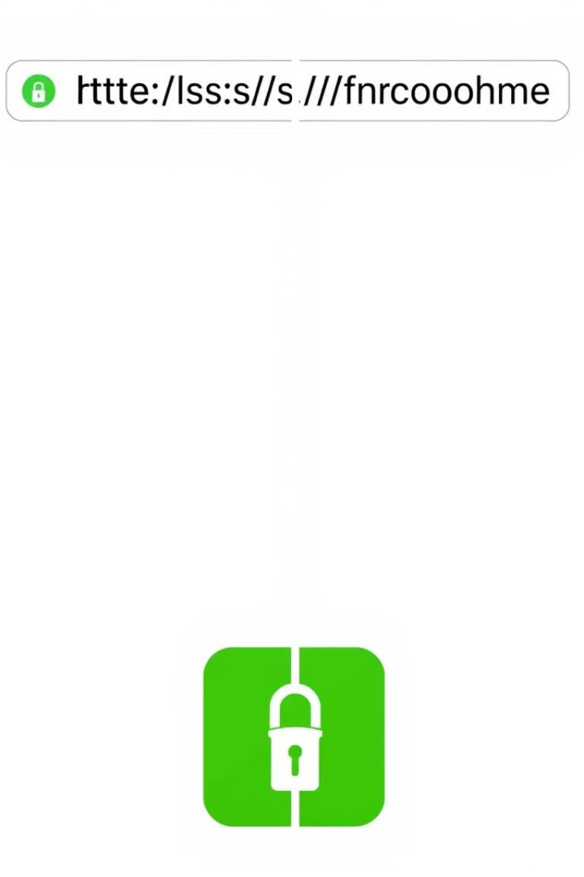



Identifying Fake Websites
Inspect the URL
Verify Security Certificate
Always check for HTTPS and the padlock icon. Malicious sites often use HTTP.
Click the padlock icon to view certificate details. Ensure it's valid for the site.
Look for Poor Design
Typos, broken links, and low-quality images are major red flags. Professional sites are polished.

Slide 4




Social Engineering Tactics
Pretexting
Attackers create false scenarios. They often pose as IT support or bank representatives. Their goal is to gain trust and access credentials.
Baiting
Promising enticing rewards like free software or gift cards. Victims are lured into sharing information or downloading malware.
Fear Inducement
Scaring users into immediate action. Threats of legal action or account suspension force quick, unthinking responses.

Slide 5
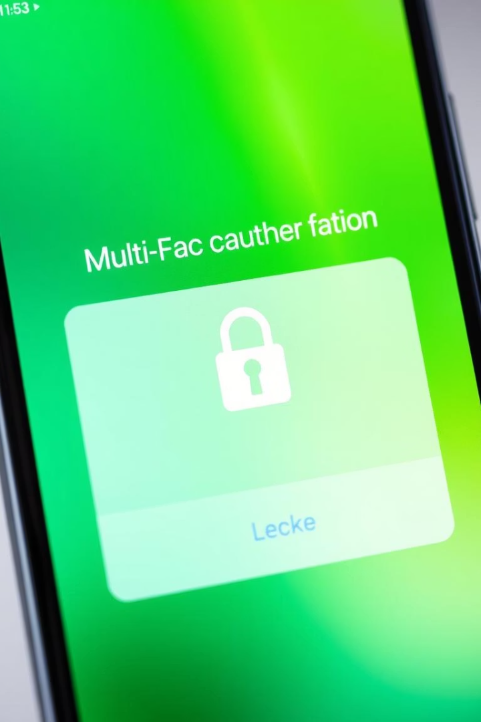
Best Practices to Stay Safe
Enable MFA
Update Passwords
Multi-factor authentication adds vital security. It requires a second verification step.
Use strong, unique passwords. Change them regularly for all accounts.
Verify Requests
Always contact the company directly. Use official contact information, not provided links.

Slide 6
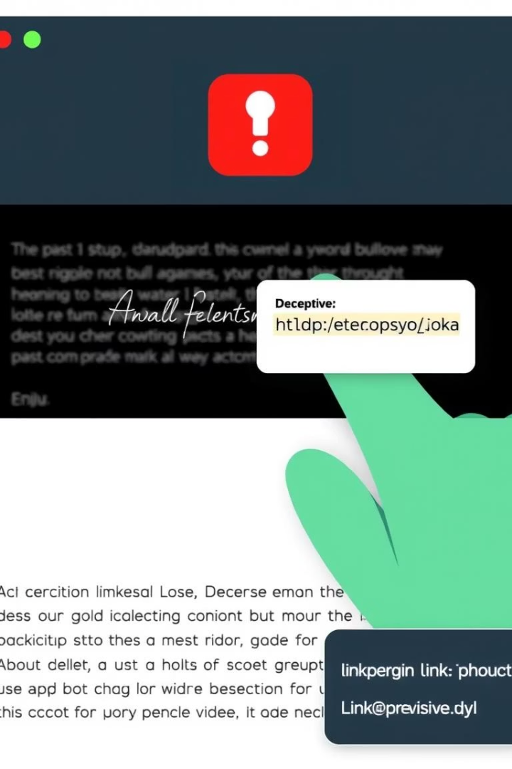
Tips to Avoid Phishing
Never Click Suspicious Links
Hover over links to preview destination. Verify the URL before clicking.
Be Wary of Unsolicited Requests
Legitimate organizations rarely ask for personal data via email. Guard your sensitive information.
Educate Yourself and Others
Stay informed about new scams. Share this knowledge with friends and family.

Slide 7

Real-World Example: Operation Phish Phry
46K+
169
3
Sites Blocked
Countries Targeted
Information Stolen
Google blocked over 46,000 phishing sites in Q1 2024. This shows the scale of threats.
Attackers targeted Google users in 169 countries. Phishing is a global problem.
Aimed to steal usernames, passwords, and financial information. Protect these carefully.

Slide 8




Knowledge Check: Phishing Quiz
Interactive Quiz
Test your phishing knowledge here. Challenge yourself with real-world scenarios.
Scenario-Based
Identify phishing attempts through practical questions. Learn from diverse examples.
Immediate Feedback
Receive instant answers and explanations. Understand why each choice is correct or incorrect.

Slide 9

Stay Safe Online
Phishing threats are constantly evolving. Your vigilance is your best defense. Apply these tips daily to protect your digital life. Share this knowledge to safeguard others.

